Slide 1
Name of the Faculty
Department | Computer Science
Designation | Assistant Professor
Name of the Course | Data Structures & Algorithms
Semester | III
Course Code | 24BCS33C
Batch | 2024
Unit & Course Topic | Unit -I: Introduction to Data Structures

Slide 2
Syllabus: Unit - I
Basic Concepts: Overview: System Life Cycle - Algorithm Specification: Introduction- Performance Analysis: Space Complexity- Time Complexity-Asymptotic Notation - Arrays: The Abstract Datatype – Sparse Matrices – The Abstract Datatype-Sparse Matrix Representation – Transposing a Matrix. Stacks and Queues: Stacks – Queues - Evaluation of Expression – Multiple Stacks and Queues

Slide 3
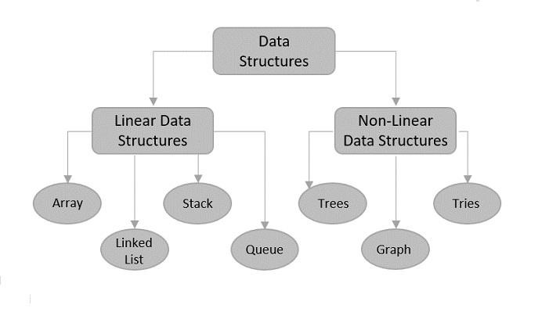
Introduction
A data structure is a way of organizing and storing data in a computer so that it can be accessed and used efficiently.
It refers to the logical or mathematical representation of data, as well as the implementation in a computer program.

Slide 4
Why Data Structures
Efficient Data Organization and Management
Optimized Algorithms and Code Performance
Improved Code Understandability and Maintainability
Facilitates Problem Solving
Enables Data Retrieval and Manipulation

Slide 5
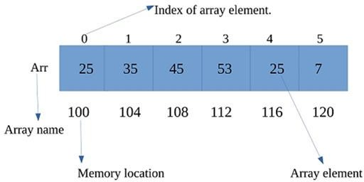
Arrays
An array is a fundamental linear data structure that stores a collection of elements of the same data type in contiguous memory locations
Each element in an array can be accessed directly using its index, starting from 0.

Slide 6
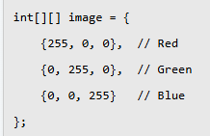
Application of Arrays
Storing Data in Storing Data in Databases
Array Type | Example Usage
One Dimensional Arrays | Storing a list of customer names.
Two-Dimensional Arrays | Storing product details in rows and columns.
Image Processing
Image is represented as two-dimensional array of Each pixel can be represented by
a color value, which can be manipulated using array operations pixels

Slide 7
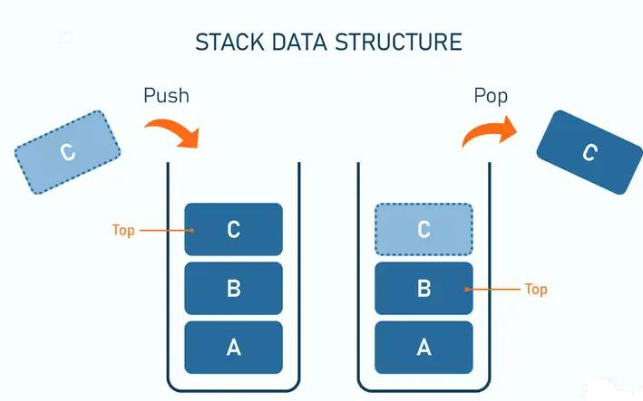
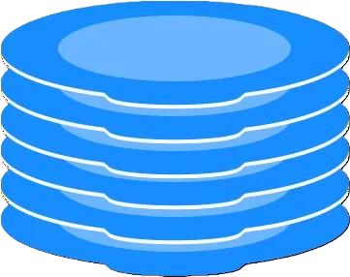
Stacks
A stack is a linear data structure that operates on the Last- In, First-Out (LIFO) principle.
This means the last element added to the stack is the first one to be removed.
Stack representation similar to a pile of plate

Slide 8
Applications of Stack
Undo in apps: Editing text or images? Each change is added to a stack. Undo removes the last change first.
Browser history: Every page you visit is pushed onto a stack. Clicking back pops the most recent page.
Function calls in programming: Recursive functions push each call onto a stack, returning step-by-step when done.
Syntax validation: Checking if brackets or parentheses match in code relies on a stack to track openings and closings.
Backtracking in games: Games use stacks to track previous moves when exploring mazes or puzzles.

Slide 9
Question Bank
Section - A
1.Which of the following statement is correct about array?
a) The size of the array is fixed. b) The size of the array is dynamic. c) Random access is not possible in an array.
d) None of these
The data structure required to check whether an expression contains a balanced parenthesis is?
Stack b) Queue c) Array d) Tree
A Stack follows Principle
FIFO (First In First Out) b) LIFO (Last In First Out) c) Ordered array d) Linear tree
Which data structure is used for implementing recursion?
Queue b) Stack c) Array d) List
Which of the following is the linear Data Structure
Arrays b) Linked Lists c) Stack d) All of the Above
Section – B
Differentiate between Linear and Non Linear Data Structures
Explain array based implementation of Stack
Describe about Stack ADT in detail
Section – C
Develop and Show the simulation using stack for the following expression : 12 + 3 * 14 – (5 * 16) + 7 .
Write an algorithm for inserting and deleting an element into the Stack
Define Data Structures .Explain various types of Data Structures in detail.

Slide 10
References
URL References :
https://www.programiz.com/dsa/stack
https://www.hackerearth.com/practice/data-structures/arrays
https://www.tutorialspoint.com/data_structures_algorithms
Book References:
“Data Structures Using C” by E Balagurusamy.
“Fundamentals of data structures in C” by Horowitz, Ellis
Online Tool Used
https://quizizz.com/
https://www.mentimeter.com/

Slide 11
THANK YOU

